Slide 1

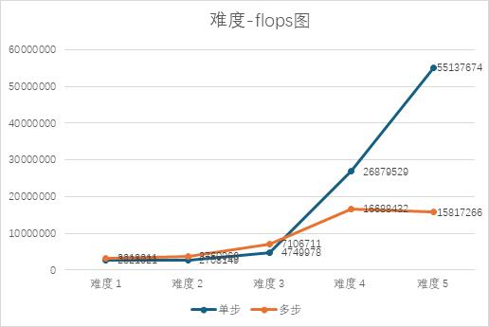
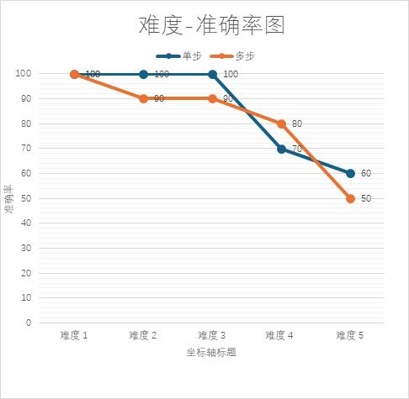
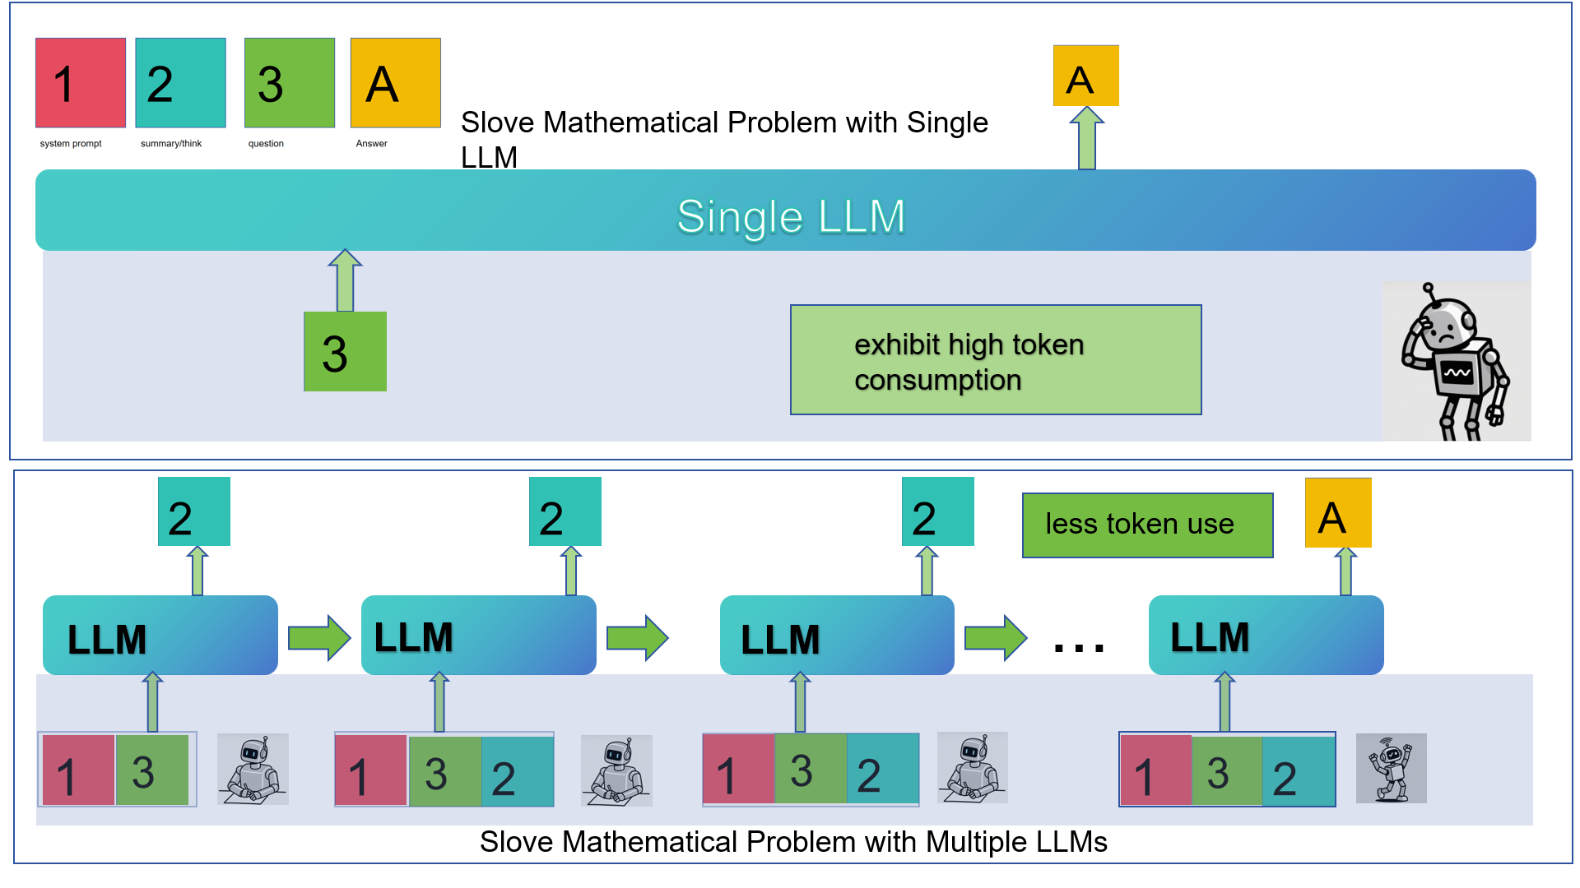
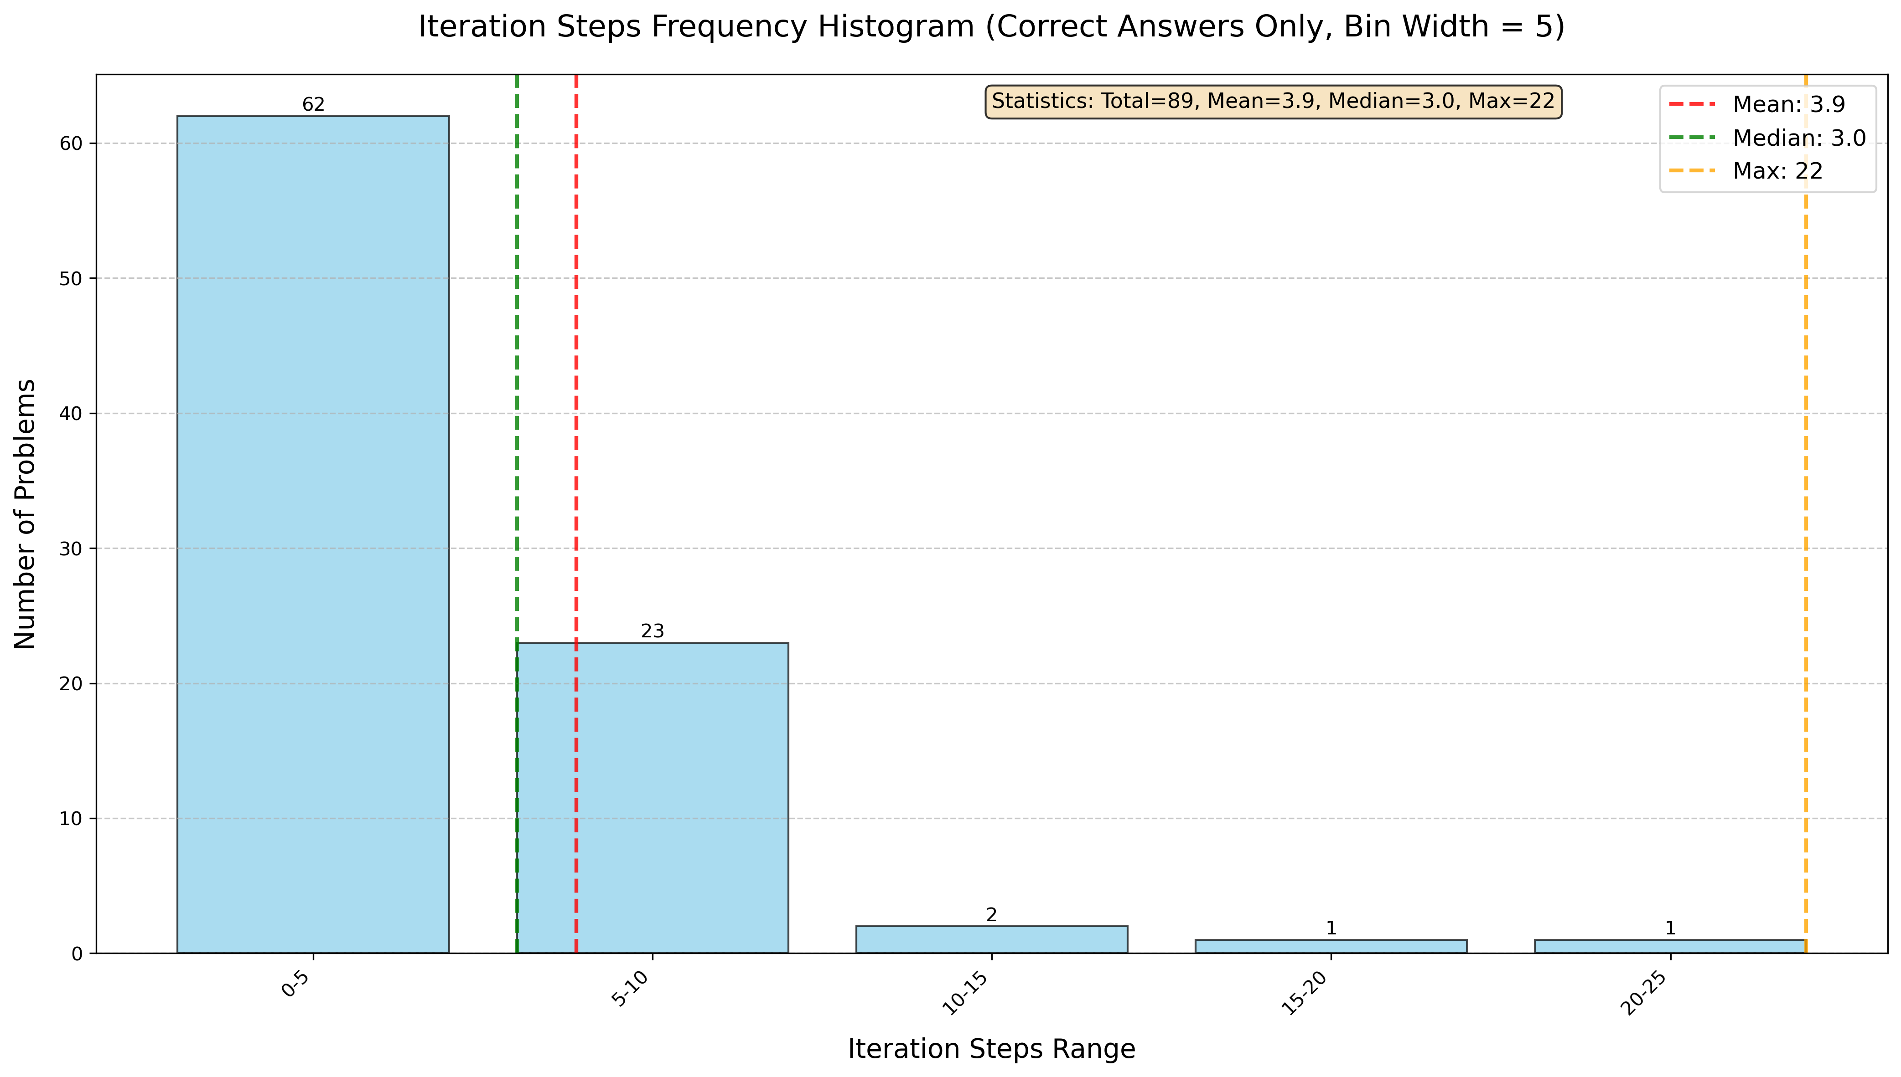
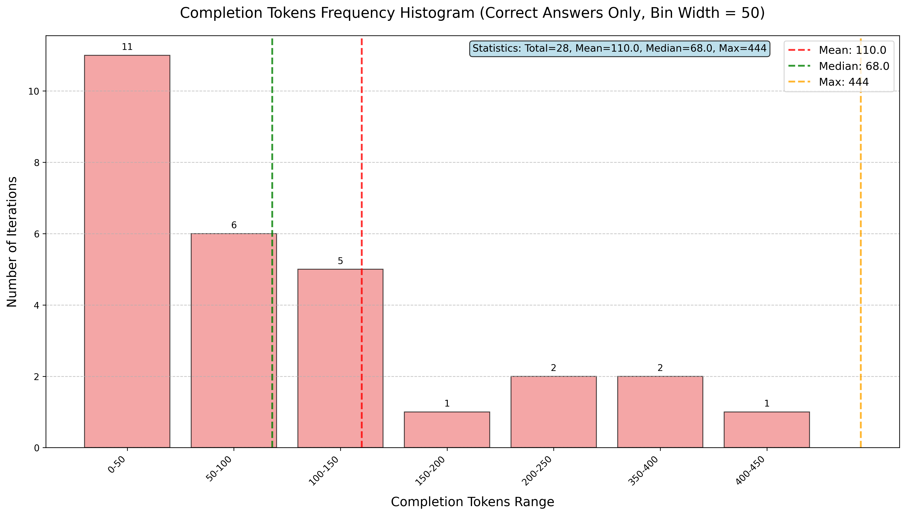
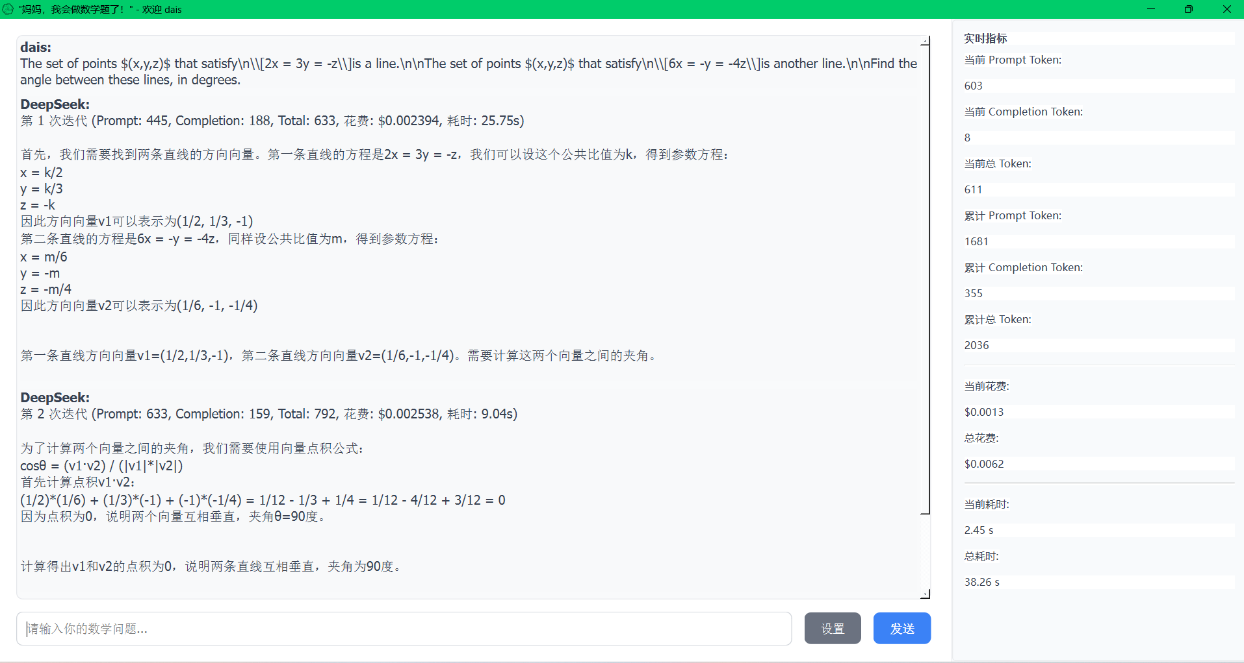
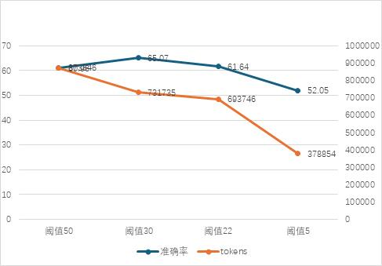
  Does the modality adaption help?
SUMMARY AND ITERATIVE MATH PROBLEMS SOLVER,BASED ON LARGE LANGUAGE MODEL(LLMS) MULTIPLE ROUNDS INFECTION
Tengfei Zhang¹, Minbo Yu¹, Haolan Zhang¹, Shibo Dai¹
NLP Lab, School of Computer Science and Engineering, Northeastern University¹
NiuTrans Research³
Introduction
Difficulty-Flops-Accuracy
This proposal presents a novel framework for solving complex math problems through iterative reasoning and summarization powered by large language models (LLMs). Unlike single-step solutions, our approach decomposes problems into multi-step reasoning chains, dynamically refining intermediate conclusions via summarization iterations. This mimics human-like problem-solving processes and addresses the limitations of direct LLM inference in handling mathematical logic, symbolic operations, and long-horizon dependencies. For automated math problem solving, the system balances total required length, computational cost, and latency against core objectives of accuracy, interpretability, and robustness.We will implement this process as an interactive math problem solver that visually displays the iterative reasoning steps, allowing users to observe the dynamic refinement of solutions in real-time.
Figure 4
Figure 5
Prompt
It can be seen from the diagram that as the difficulty increases, the multi-step token is much smaller than the single-step token consumption, and the accuracy difference is not large.
Process Flow: Initial Thought → Summary → Continued Reasoning → Summary → ... → Final Answer The process terminates after the final answer is provided.
Iteration-Token
Figure 1
Figure 2
GUI
1. Count the correct iteration step distribution of the highest difficulty data set problem to confirm the iteration step threshold
2. Remove the length limit, select the ten most difficult problems to record the completion _ tokens consumed by each iteration, analyze the result data, and optimize the value of max _ token.
Iteration-Accuracy
Conclusion
When the difficulty is low, the single-step method performs better than the multi-step method in terms of accuracy and flops, while when the difficulty is high ( starting from difficulty four ), the flops used by the multi-step method are significantly lower than those of the single-step method. It shows that the multi-step iterative method is superior to the single-step method in solving difficult mathematical problems.
Under the maximum difficulty of division, although the accuracy of the multi-step method is about 16 % lower than that of the single step, the completion _ tokens single step is 201945, while the multi-step is 133514, and the flops single step is 651039582 and the multi-step is 238661068. It can be seen that the multi-step iterative solution method under high difficulty can significantly reduce the computational complexity of the model and generate the tokens required for the answer. The correctness of conclusion one is verified.
Figure 3
The accuracy rate and token costs change with the number of iteration steps. It can be seen from the figure that the accuracy rate decreases as the threshold decreases, while total costs are also lower.

